Slide 1
Android College Connect Chat App
Supervisor: Dr. Vipin Kumar
Associate Professor in MCA Department

Slide 2
Team Members
Mansi Varshney(Team Leader)
Yash Kumar
KM Palak

Slide 3
Overview
This project is insight into the design and implementation of an Android College Connect Chat App. Hence to solve this issue we have come up with an android based College Connect Chat application where all the students & teachers can stay connected together on a single platform, thereby helping all the students to be in constant touch with the faculties and making it possible for them to get their problems solved in an instant.
Hence, this android-based application will help students to be in contact with their fellow mates & professors all the time without being physically present in a classroom. Without depending on third party application, college have their own intra communication application to connect students and faculties.

Slide 4
Working of the Project
This system is basically a kind of forum where teachers and faculties can come together and share their view. The Admin is the College here who is responsible to create profiles of all the students and faculties. There are four kinds of levels or forums involved here:
College - here all the students and faculties can participate and admin can add events and circulars.
Department – all the students and faculties can participate of the same department can participate.
Year – all the students can participate of the same Year.
Section – all the students can participate of the same Section.

Slide 5
System Requirements
1. Hardware Requirement
a. Laptop or PC
- I3 processor system or higher
- 4 GB RAM or higher
- 100 GB ROM or higher
2. Software Requirement
b. Laptop or PC
- Windows 7 or higher
- Android Studio
Android Phone (6.0 and above)

Slide 6
Features
Messaging
One of the primary uses of K-CHAT is messaging. Just like other social apps, you have a list of
conversations that you’re engaged in.
File transfer
With the sophistication design of the K-CHAT app, individuals will be able to share files without
size constrains ranging from images, videos, to large documents files like zip, dmg, and so on.
Social barrier breaker

Slide 7
Advantages
Instead of using any 3rd party app, the college has its own chatting application.
Accounts are created directly by admin, so no place for intruders.
Forums are segregated based on Levels i.e. Section or Year or Department etc.
Students and Faculties can chat with their each other on personal levels i.e. no forums.

Slide 8
Disadvantages
Wrong inputs will affect the project outputs.
Internet Connection is mandatory.
Messages cannot be deleted

Slide 9
DELIVERABLES
There are 5 major things I hope to achieve with this application, which include-
I. Speed in usage
II. Easy and friendly UI
III. Privacy Protection
IV. Promoting Unity
V. Economic boost

Slide 10
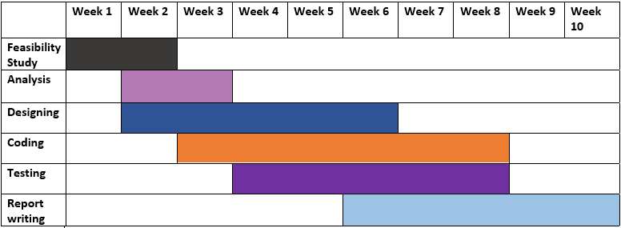
Gantt Chart

Slide 11
Thank You

